Slide 1
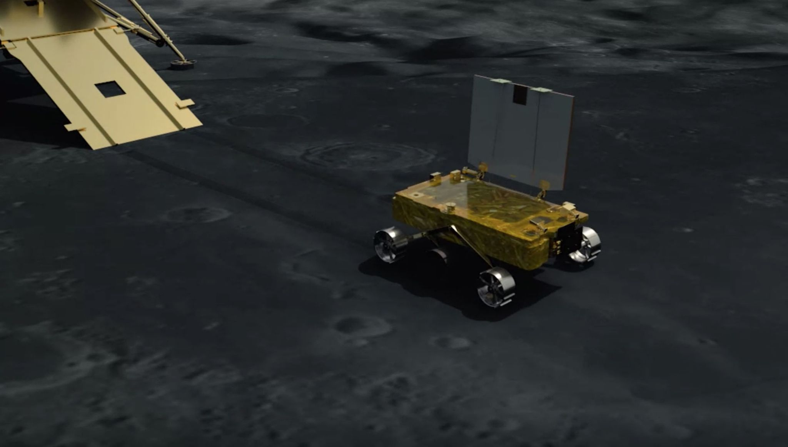

Artificial Intelligence for Lunar Exploration

Slide 2
INDEX
1). Introduction of whole project, how will everything proceed?
2). Why moon is important?
3). Previous and Upcoming Moon missions
4). Lunar Mineralogy
5). Lunar Environment and gravity
6). Brief intro of a typical lunar rover
7). Importance of autonomous rovers
8). How machine vision works?
9). What we will cover in this project
10). Advice for the further progress in the project

Slide 3
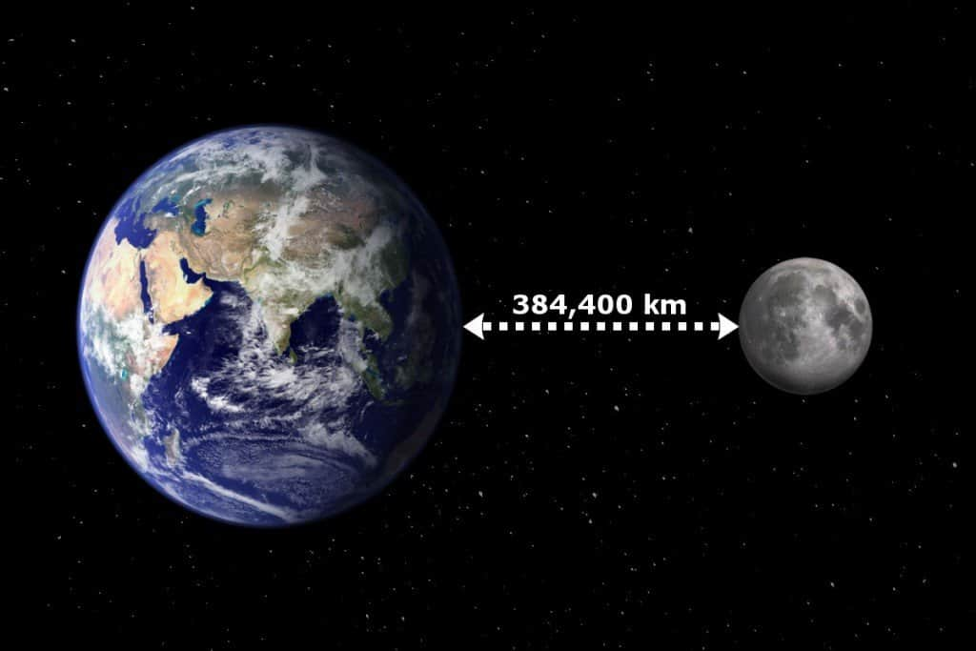
Why moon is important?
Distance - Closest Astronomical Object to the Earth
1

Slide 4
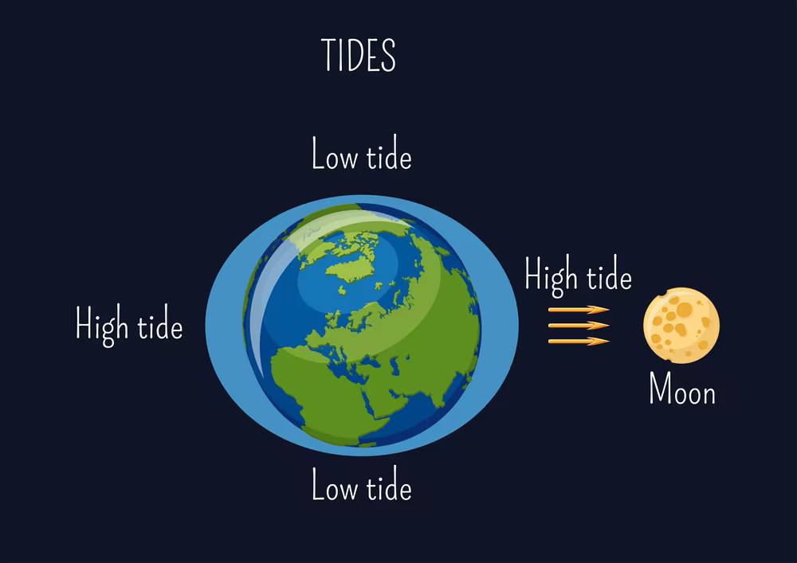
Why moon is important?
Distance - Closest Astronomical Object to the Earth
It also causes tides, creating a rhythm that has guided humans for thousands of years.
1

Slide 5
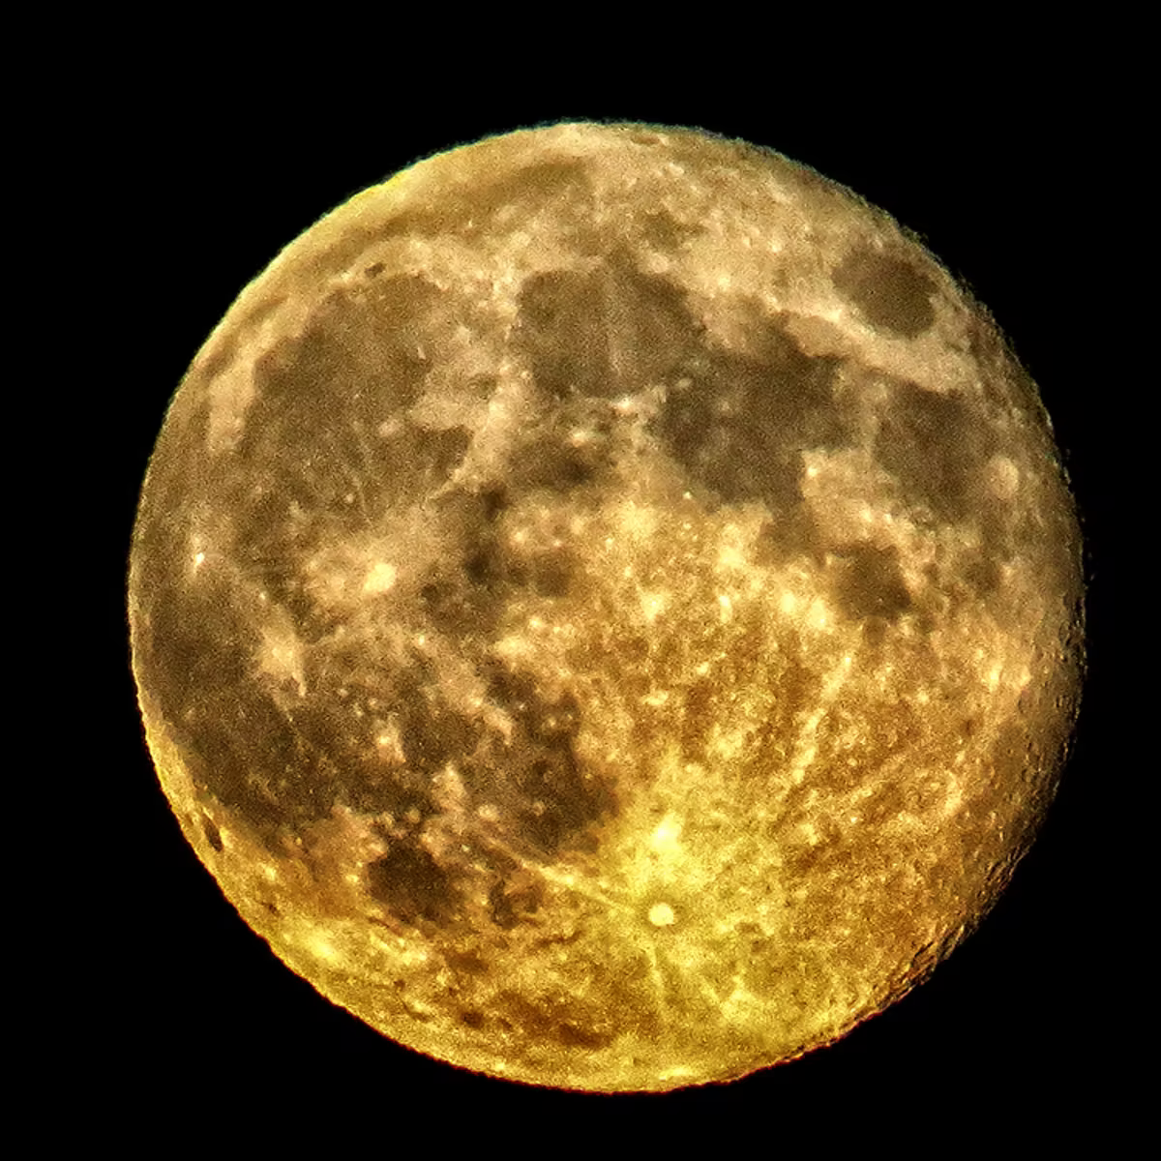
Why moon is important?
Distance - Closest Astronomical Object to the Earth
It also causes tides, creating a rhythm that has guided humans for thousands of years.
The Moon also has technological and economic value.
1

Slide 6
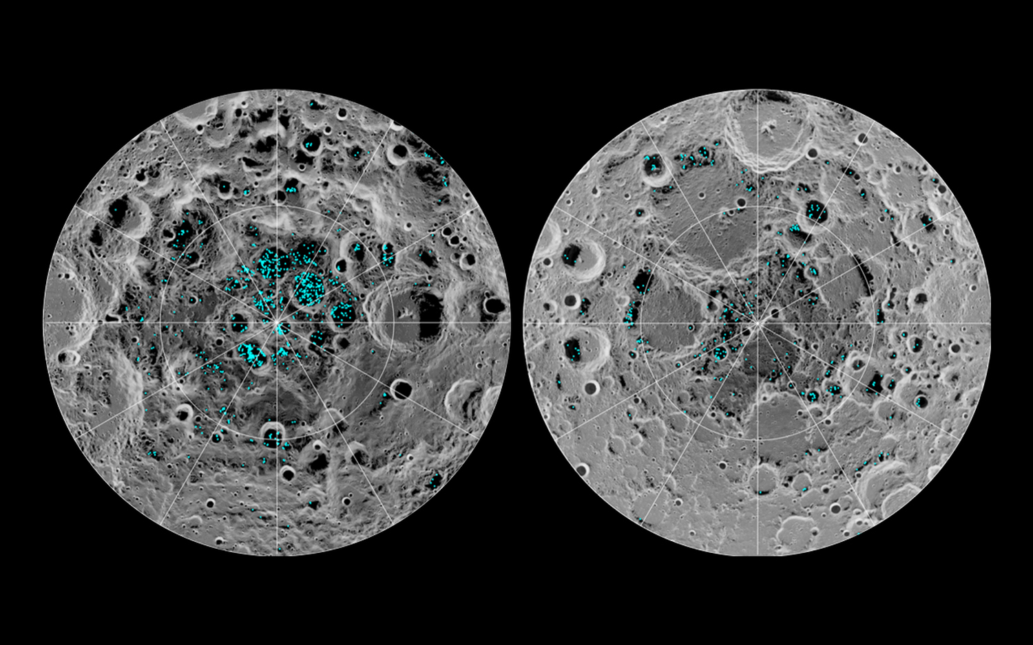
Why moon is important - last discoveries?
In the last two decades,
NASA and ISRO spacecraft have discovered water ice on the Moon’s poles. Future human habitats on the Moon could tap into this water ice for drinkable water, breathable air and rocket fuel.
1

Slide 7
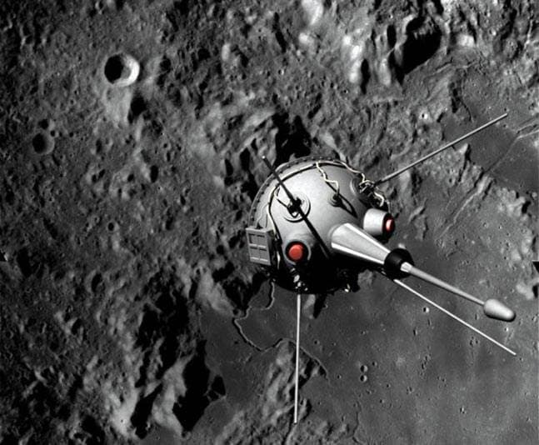
Previous Moon Missions
Luna 2- This unmanned Soviet probe became the first man-made object to make contact with another planetary body. The spherical spacecraft launched on Sept. 12, 1959 and impacted the moon two days later.
2

Slide 8
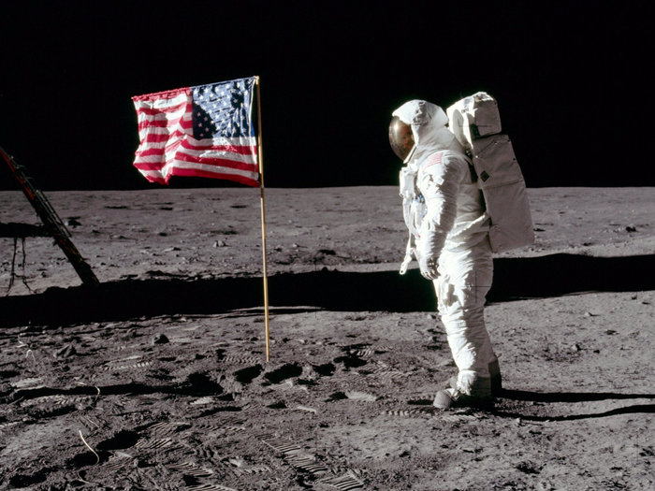
Previous Moon Missions
Luna 2
Apollo - The Apollo program by NASA accomplished landing the first humans on the Moon from 1969 to 1972. During the Apollo 11 mission, astronauts Neil Armstrong and Buzz Aldrin landed their Apollo Lunar Module (LM) and walked on the lunar surface, while Michael Collins remained in lunar orbit in the command and service module.
2

Slide 9
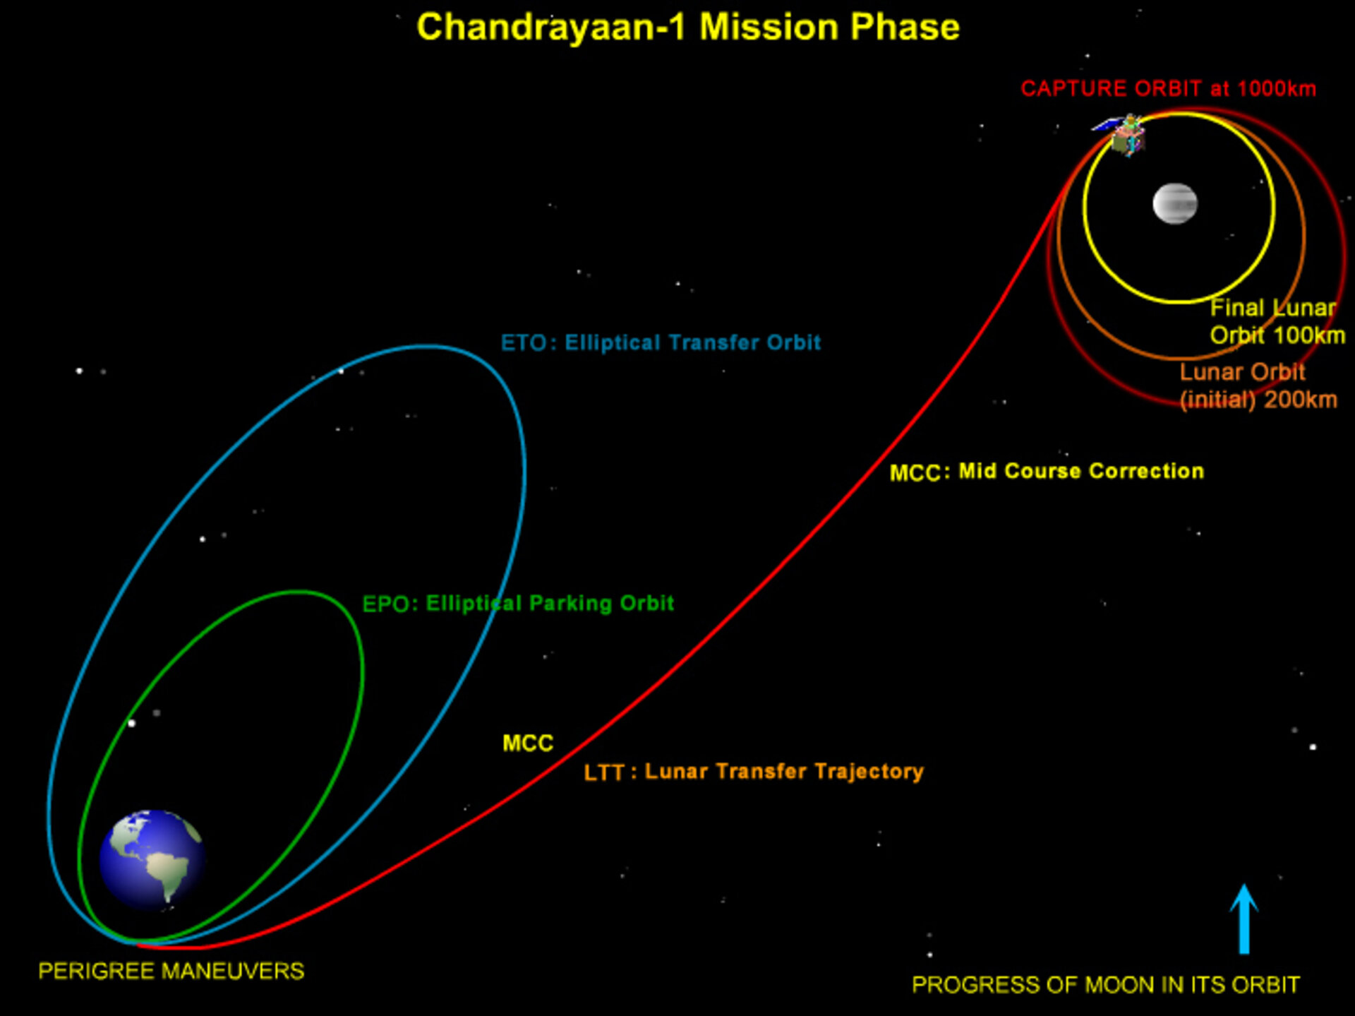
Previous ISRO Moon Missions-
Chandrayaan-1- Launched on Oct. 22, 2008, India's first mission beyond Earth, the probe observed the moon from orbit until August 2009.
In September 2009, results from one of Chandrayaan-1's instruments, the Moon Mineralogy Mapper, helped detect evidence for water on the moon.
5

Slide 10
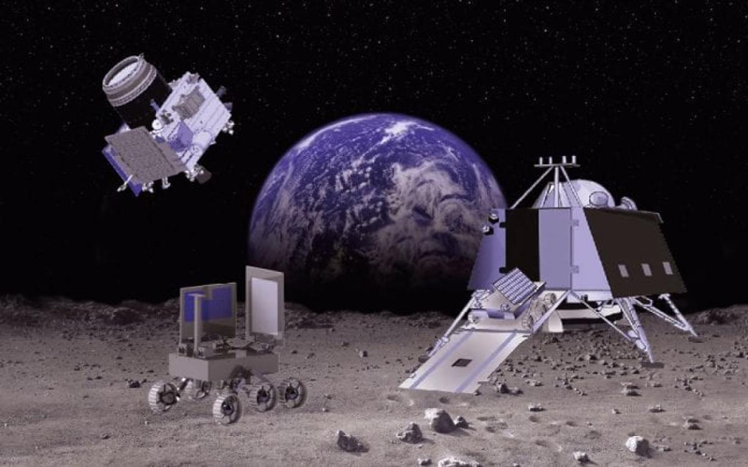
Previous ISRO Moon Missions-
Chandrayaan-2- Launched on 22 July, 2019, it is the second lunar exploration mission developed by ISRO.
It consists of a lunar orbiter, and also included the Vikram lander, and the Pragyan lunar rover, all of which were developed in India.
The main scientific objective is to map and study the variations in lunar surface composition, as well as the location and abundance of lunar water. Unfortunately, the lander crashed while landing due to a software glitch.
5

Slide 11
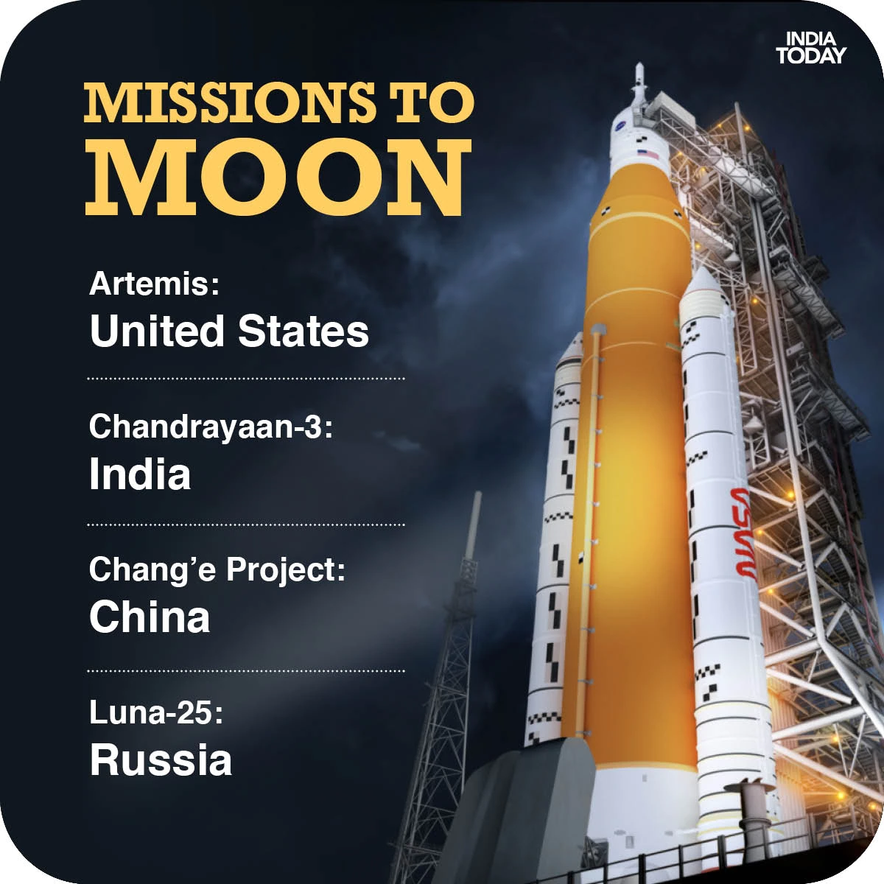
Upcoming Moon Missions-
Chandrayaan-3 - It will be a mission repeat of Chandrayaan-2 but will only include a lander and rover similar to that of Chandrayaan-2. It will not have an orbiter. The spacecraft is planned to be launched in the third quarter of 2022. (We need to hurry!!)
5

Slide 12

Upcoming Moon Missions-
ARTEMIS - The Artemis program is a United States-led international human spaceflight program. Its primary goal is to return humans to the Moon, specifically the lunar south pole, by 2025. If successful, it will include the first crewed lunar landing mission since Apollo 17 in 1972, the last lunar flight of the Apollo program.
5

Slide 13
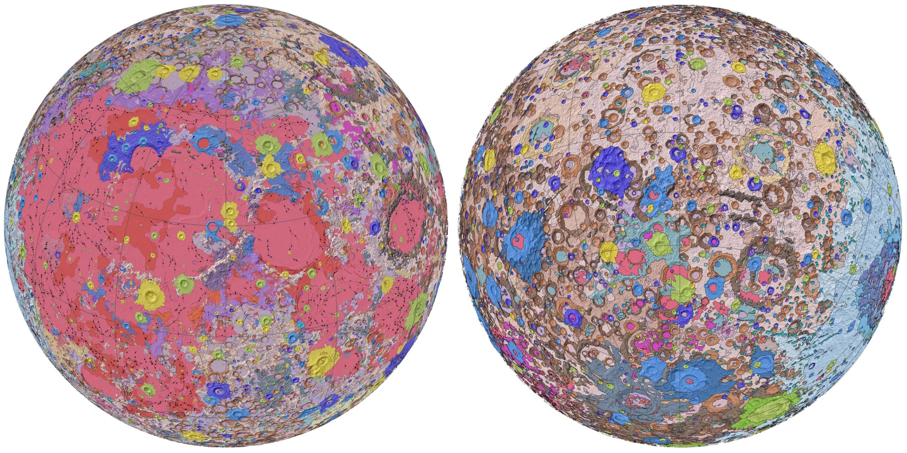
Lunar Mineralogy
Topographic map of the front and far sides of the Moon, in which stereo data provided elevation differences from high resolution photographs and radar altimetry data, acquired by the Clementine spacecraft as it orbited the lunar surface.
6

Slide 14
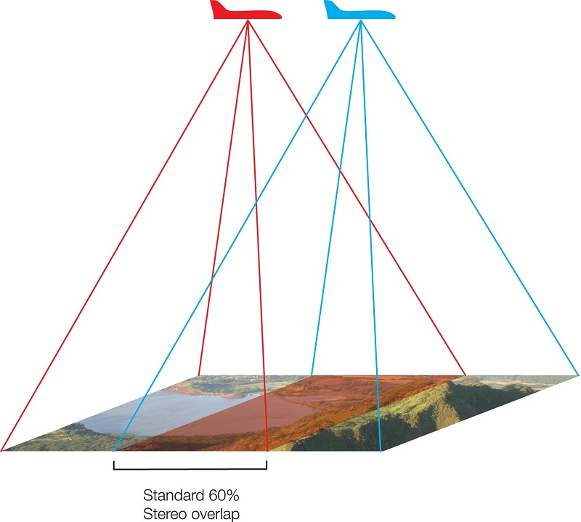
Lunar Mineralogy
stereo data
Topographic map of the front and far sides of the Moon, in which stereo data provided elevation differences from high resolution photographs and radar altimetry data, acquired by the Clementine spacecraft as it orbited the lunar surface.
6

Slide 15
Lunar minerals do not react appreciably with the Earth’s atmosphere, although akaganeite (FeO(OH)) was found on the surface of one Apollo 16 breccia. Slow oxidation of metallic Fe grains does occur, but the classic problem of catalytic oxidation by lawrencite (FeCl 2 ) does not seem to be the problem that it is with some meteorites. The Apollo Lunar Sample Collection is preserved in dry nitrogen cabinets.
To know more about the image in detail- https://astrogeology.usgs.gov/search/map/Moon/Geology/Unified_Geologic_Map_of_the_Moon_GIS_v2
7

Slide 16
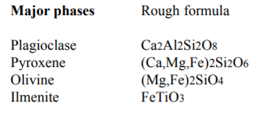
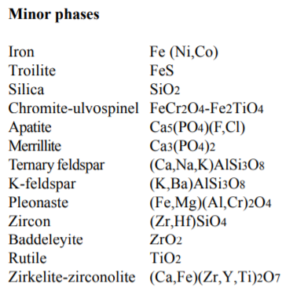
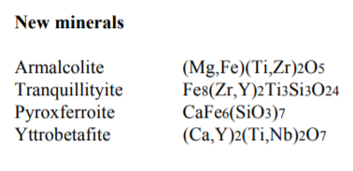
List of minerals reported in Lunar samples
8

Slide 17
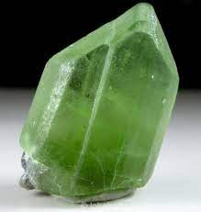
Uses of Olivine
Most olivine is used in metallurgical processes as a slag conditioner. High-magnesium olivine (forsterite) is added to blast furnaces to remove impurities from steel and to form a slag.

Slide 18
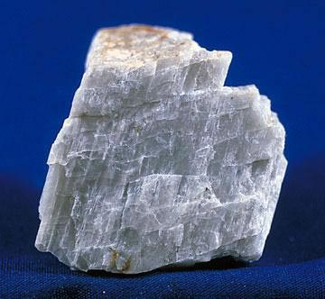
Plagioclase
Plagioclase is used in the manufacture of glass and ceramics; the iridescent varieties peristerite and labradorite are valued as gemstones or ornamental material. The primary importance of plagioclase, however, derives from its role in rock formation.

Slide 19
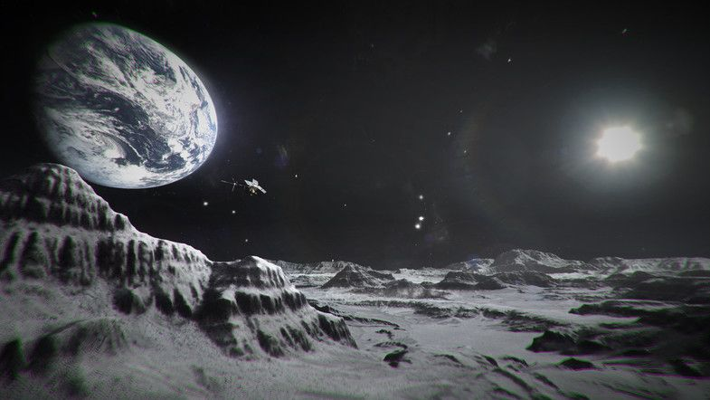
Lunar Environment and gravity
Earth's Moon is the only place beyond Earth where humans have set foot. The Earth's moon presents a hostile environment.
9

Slide 20
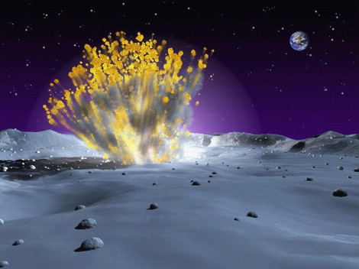
Lunar Environment and gravity
The moon's surface is covered with a thin layer of fine, charged, reactive dust capable of entering habitats, and vehicle compartments, where it can cause crew member health problems.
9

Slide 21
SOIL COMPOSITION
The lunar regolith is chemically composed of several elements and compounds in varying concentrations.
10

Slide 22
SOIL COMPOSITION
The lunar regolith is chemically composed of several elements and compounds in varying concentrations.
The carbon, hydrogen, and nitrogen found in the soil are almost entirely due to implantation by the solar winds.
10

Slide 23
SOIL COMPOSITION
The lunar regolith is chemically composed of several elements and compounds in varying concentrations.
The carbon, hydrogen, and nitrogen found in the soil are almost entirely due to implantation by the solar winds.
Unlike most Earth soils, the lunar soil has high concentrations of sulfur, iron, magnesium, manganese, calcium, and nickel.
Many of these elements are found in oxides such as FeO, MnO, MgO, etc. Ilmenite (FeTiO3), most common in the mare regions, is the best source of in situ oxygen.
10

Slide 24
ATMOSPHERE
Contrary to popular perceptions, the Moon does have an atmosphere.
However, it is extremely thin.
To illustrate, the entire lunar atmosphere, compressed to Earth surface temperature and pressure, would fit into a 210 foot cube.
12

Slide 25
ATMOSPHERE
Although the research is not complete, helium, argon, sodium, and potassium have been identified as atmospheric elements.
Of these, the helium most likely comes from the solar wind, while the argon originates in the lunar interior.
The discovery of sodium and potassium gives the lunar atmosphere important (research-wise) similarities to the atmospheres of Mercury.
12

Slide 26
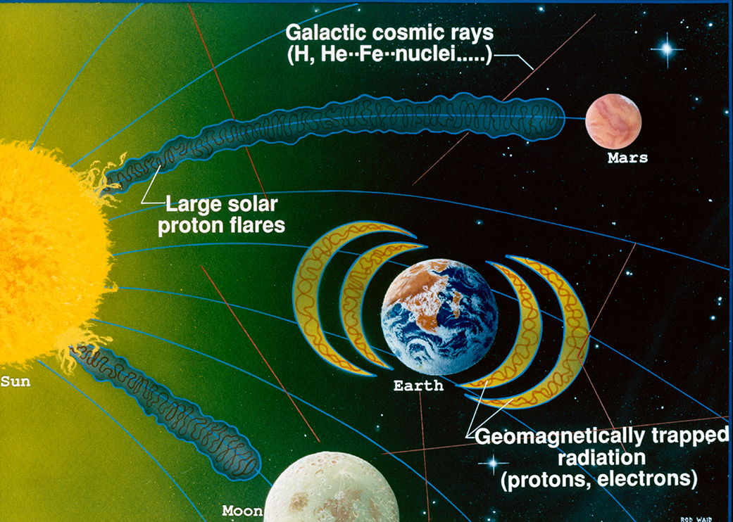
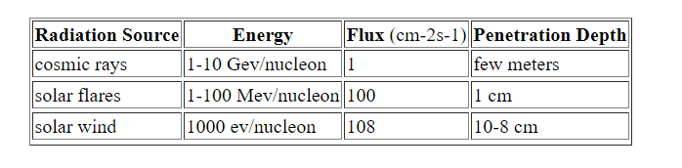
Radiation source on moon
13

Slide 27
Brief intro of a typical lunar rover
The lunar roving vehicle transported two astronauts during Apollo 15,16 and 17 missions.
The LRV (Lunar roving vehicle) carried tools, scientific equipment, communications systems and gear, and lunar samples.
The four-wheel, lightweight vehicle greatly extended the lunar area that could be explored by humans.
The LRV could be operated by either astronaut.
14

Slide 28
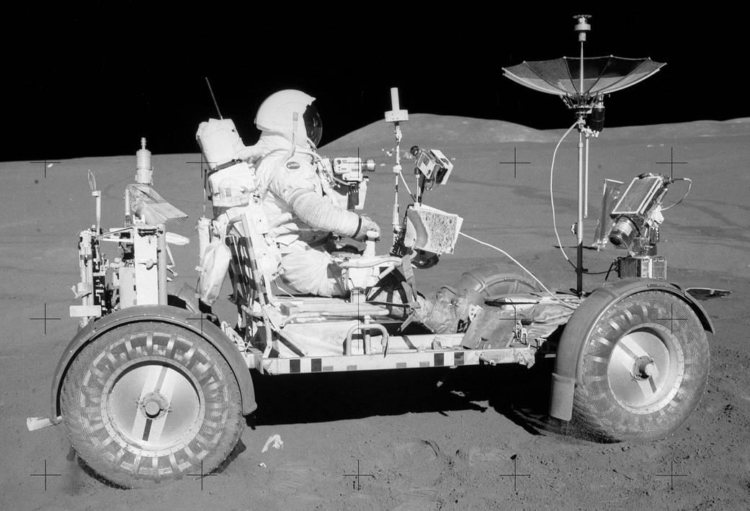
The LRV was the first manned surface transportation system designed to operate on the Moon. It marked the beginning of a new technology and represented an experiment to overcome many new and challenging problems for which there was no precedent in terrestrial vehicle design and operations.
15

Slide 29
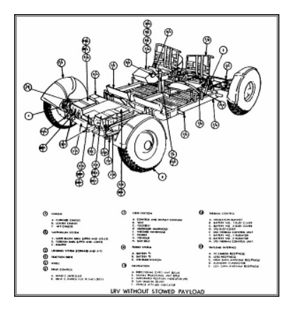
More about the vehicle can be found in :
https://airandspace.si.edu/explore-and-learn/topics/apollo/apollo-program/spacecraft/lrv.cfm
17

Slide 30
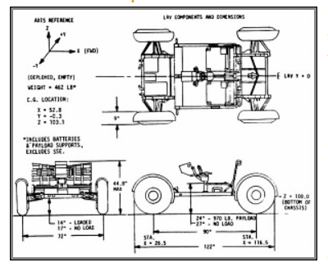
LVR description:
https://airandspace.si.edu/explore-and-learn/topics/apollo/apollo-program/spacecraft/lrv.cfm
18

Slide 31
Importance of Autonomous Rovers
Autonomous rovers can greatly amplify the productivity of the small crew.
19

Slide 32
Importance of Autonomous Rovers
Autonomous rovers can greatly amplify the productivity of the small crew.
It is also advantageous for the rovers to be responsible for their own well-being.
19

Slide 33
Importance of Autonomous Rovers
Autonomous rovers can greatly amplify the productivity of the small crew.
It is also advantageous for the rovers to be responsible for their own well-being.
To avoid getting damaged, as well as to diagnose and correct recoverable software and hardware failures.
19

Slide 34
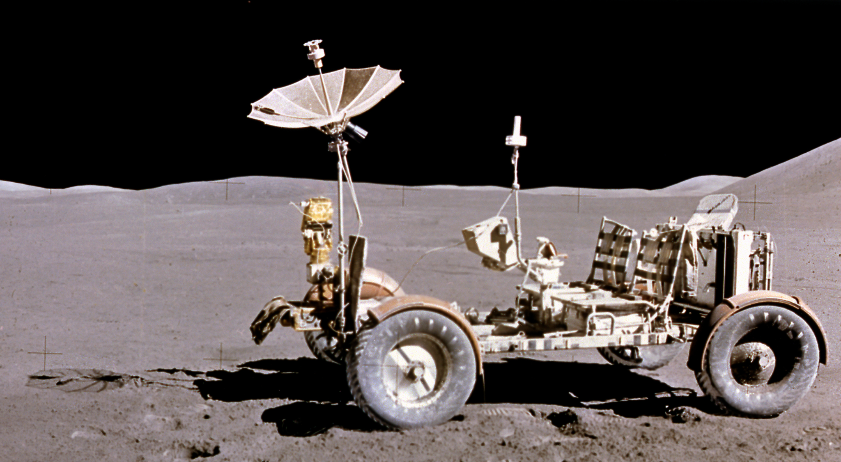
Importance of Autonomous Rovers
Autonomous rovers can greatly amplify the productivity of the small crew.
It is also advantageous for the rovers to be responsible for their own well-being.
To avoid getting damaged, as well as to diagnose and correct recoverable software and hardware failures.
With robust autonomous rovers, the crew does not have to spend time babysitting rovers and can concentrate on survival and science.
19

Slide 35
Machine Vision
Machine vision is the ability of a computer to perceive its environment.
One or more video cameras are used with analog-to-digital conversion and digital signal processing.
The image data is sent to a computer or robot controller.
It is used in a variety of industrial processes, like pattern recognition, object recognition, optical character recognition etc.
https://aijourn.com/what-is-machine-vision-everything-you-need-to-know/
20

Slide 36
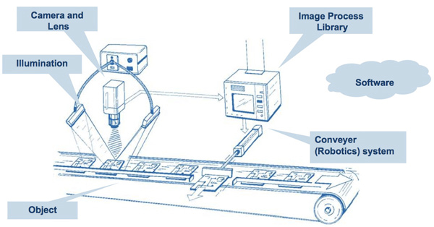

Slide 37
Components involved in machine vision
These components of machine vision systems typically include the following five elements:
The lighting system
The optical system or lens
The sensor
The vision processing system
The communications system
21

Slide 38
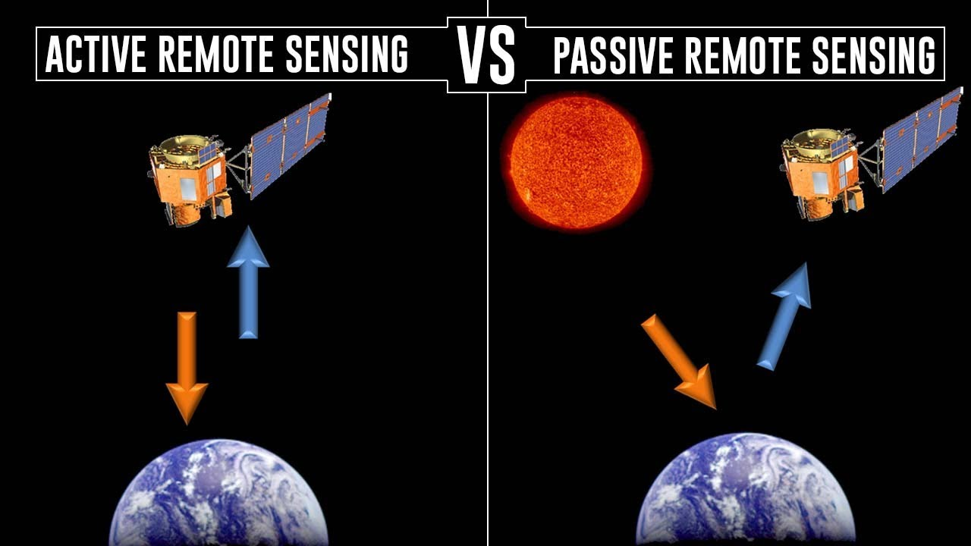
Lighting
The selection of lighting for use in a machine vision system should be made with the goal of maximizing the contrast for whatever features are of interest to be measured or observed while minimizing the contrast of all other features of the part.
22

Slide 39
Lighting
Achieving this goal may require varying the amount of light used (intensity), the style of lighting (dome vs. ring light, for example) and the placement of the light source relative to the part and the optical system or camera.
Altering these basic parameters can markedly improve a machine vision system’s ability to consistently identify and measure the part feature(s) being monitored.
Lighting options include LED lighting and strobe lights for capturing images with fast shutter speeds.
22

Slide 40
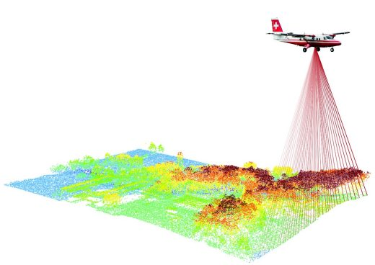

Slide 41
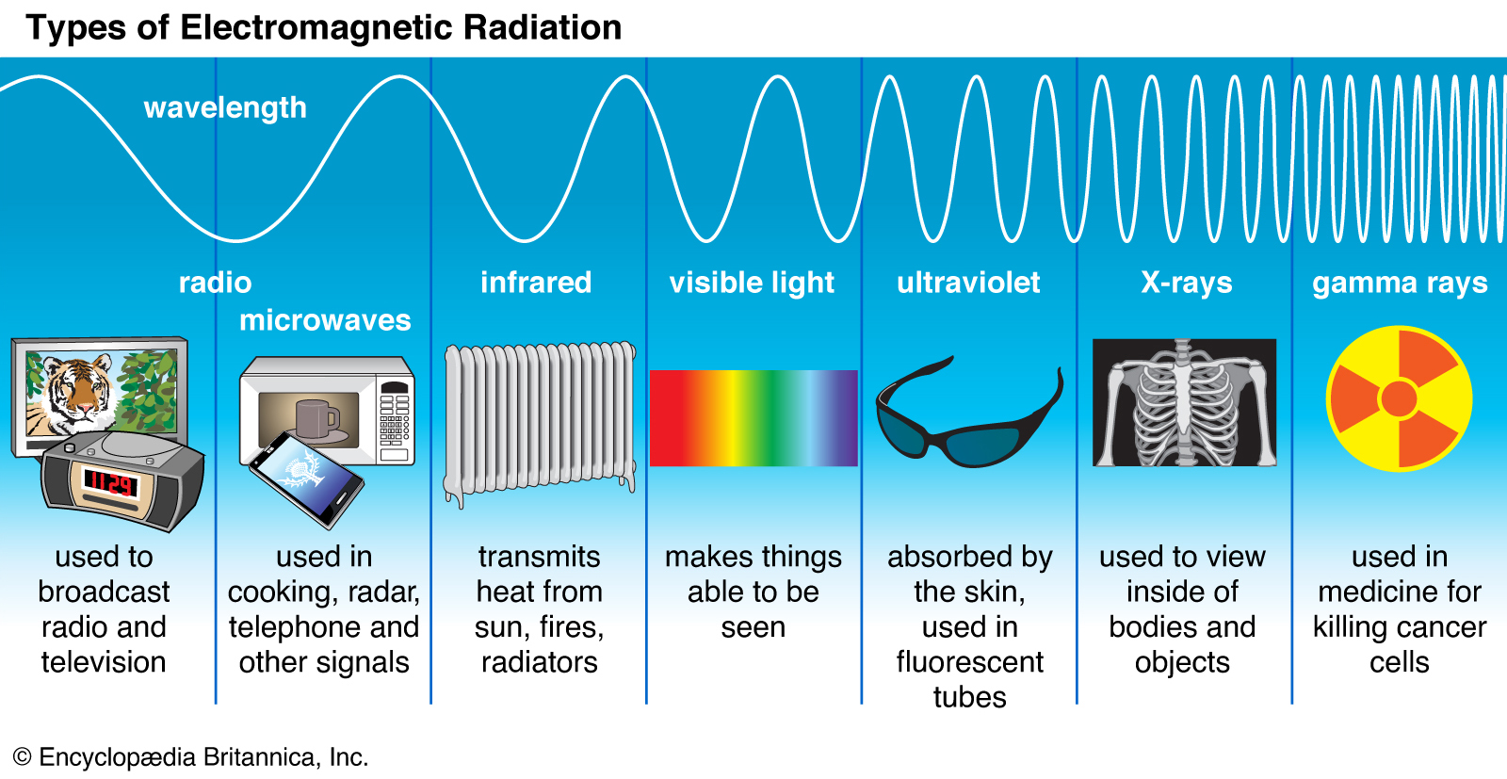

Slide 42
Optical System
The optical components in a machine vision system are typically a lens or a camera, which integrates the lens with other elements such as the sensor.
The lens selection will establish the field of view, which is the two-dimensional area over which observations can be made.
The lens also will determine the depth of focus and the focal point, both of which will relate to the ability to observe features on the parts being processed by the system.
24

Slide 43
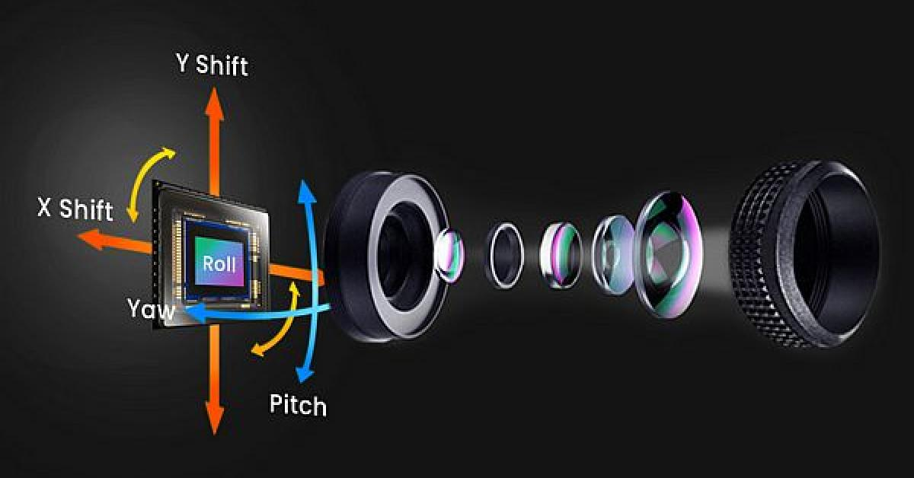

Slide 44
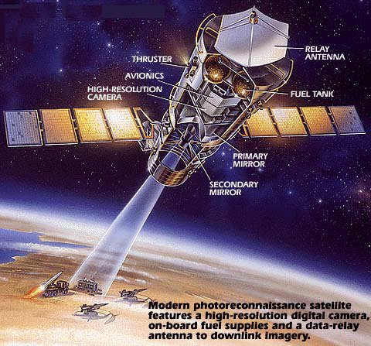

Slide 45
Lenses may be interchangeable or may be fixed as part of some designs that use a smart camera for the optical system.
Lenses that have a longer focal length will provide higher magnification of the image but will reduce the field of view.
The selection of the lens or optical system for use is dependent on the specific function being performed by the machine vision system and by the dimensions of the feature under observation.
Color recognition capability is another characteristic of the optical system element.
25

Slide 46
Sensor
Sensors used in machine vision systems serve to capture the light from the optical system and convert that into a digital image.
Sensors use CMOS or CCD technology to capture the light and convert that to a set of pixels that show the presence of light in the different areas of the original part being observed.
Sensors are measured by their resolution, which is an indication of the number of pixels available in the digital image.
26

Slide 47
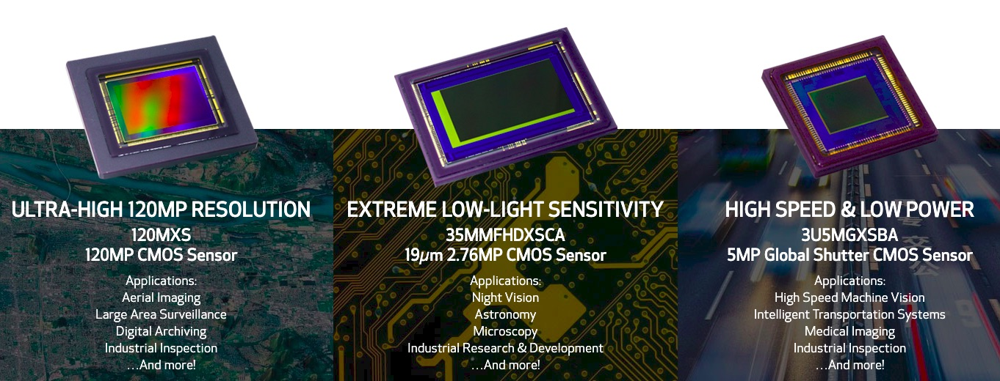

Slide 48
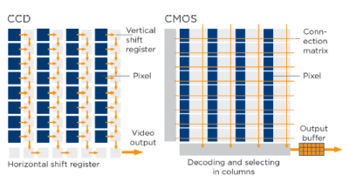
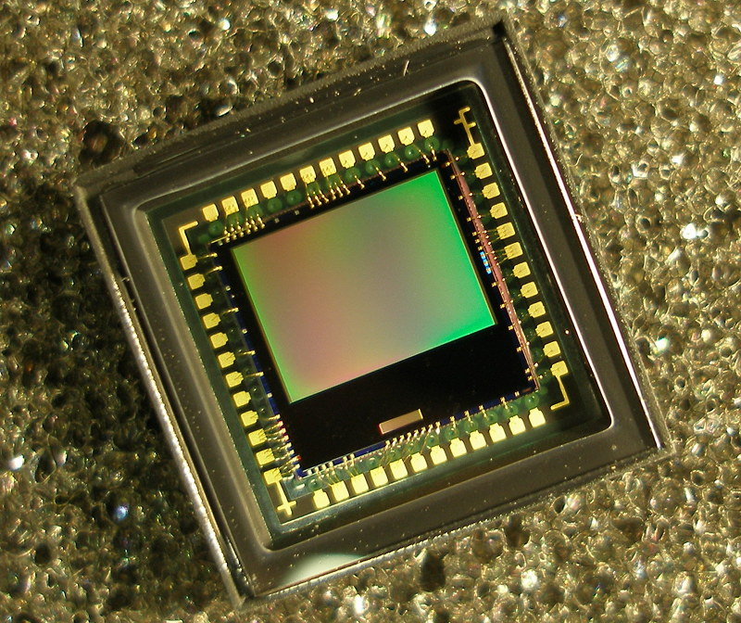

Slide 49
Sensors that have higher resolution can produce images with more pixels, which generally translates to more image quality and a greater ability to resolve details.
The resolution of the sensor is related to the sizes of the parts being observed, the dimensions of the measurements being made, the tolerances of those measurements, and other application parameters.
Higher resolutions will increase the accuracy of measurements made by the machine vision system
27

Slide 50
Vision Processing
The vision processing element of the machine vision system takes the data from the digital image and uses software to perform specific functions that are then used to evaluate the part under observation. These evaluations are pre-programmed conditions that define the acceptance and rejection criteria for the part being observed.
28

Slide 51
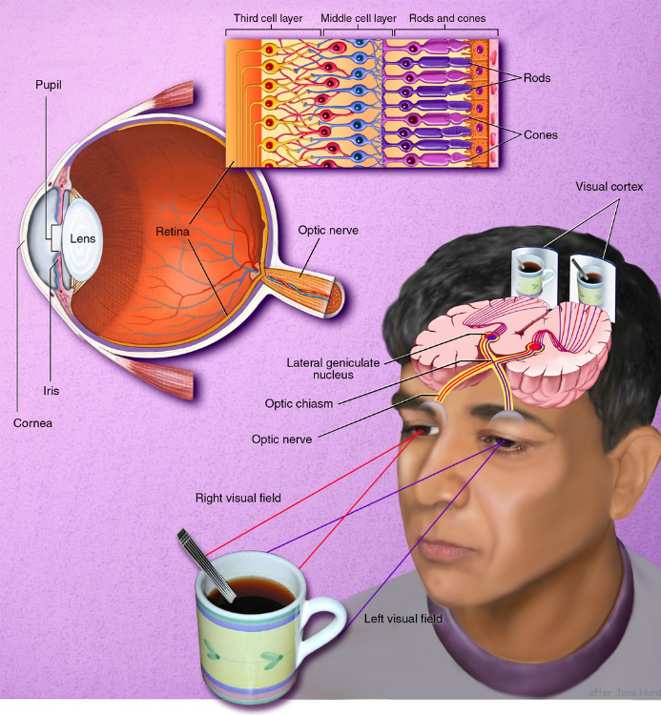
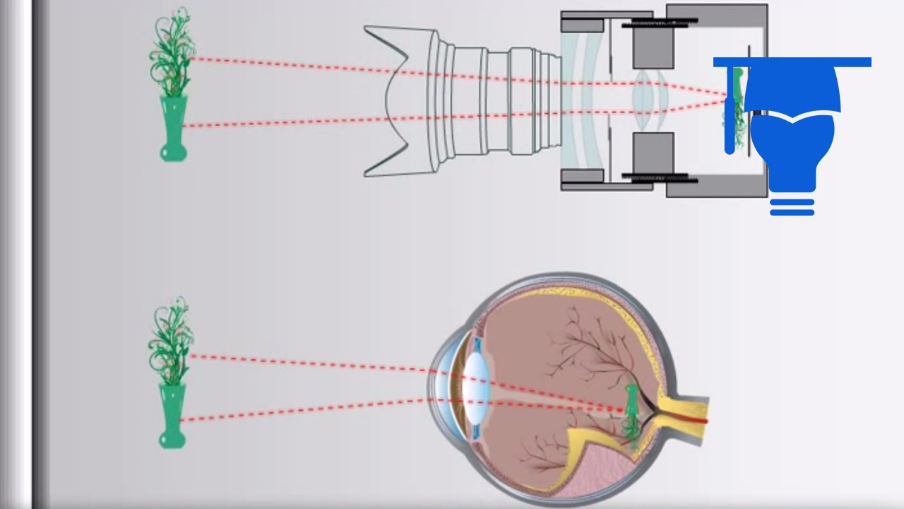

Slide 52
The steps performed by the vision processing system include:
Acquiring the digital image from the sensor
Pre-processing the image as needed to optimize it for measurements
Analyzing the image to locate the specific features of the part that need to be measured or observed
Collecting measurements of the needed features and comparing those values against the defined dimensional criteria for that feature
Establishing a result, usually as a pass-fail or go/no-go condition for that part
29

Slide 53
Communications
Once the vision processing element has completed its steps, the last element in the machine vision system involves the communications protocol.
The purpose of this element is to provide a usable output in a standardized format that can provide a usable signal to drive other components in the production process based upon the output from the vision processing system.
Standardized outputs include discrete I/O signals or serial data such as RS-232 or Ethernet sent to a logging device or other system that will make use of the data.
30

Slide 54
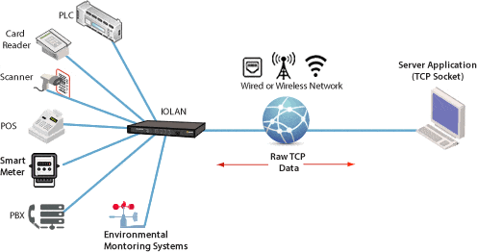

Slide 55
A discrete I/O signal may be fed to a PLC that will use that to light a stack light, or power solenoid driven actuator to move a rejected part out of the main production pathway.
A serial RS-232 data feed might be fed to an HMI screen to display information to an operator overseeing the production process.
System integrators can assist with the process of embedding communication signals between machine vision systems and other machines in the production cell.
31

Slide 56
Image Segmentation
Image segmentation is a commonly used technique in digital image processing and analysis to partition an image into multiple parts or regions, often based on the characteristics of the pixels in the image.
Image segmentation could involve separating foreground from background, or clustering regions of pixels based on similarities in color or shape.
32

Slide 57
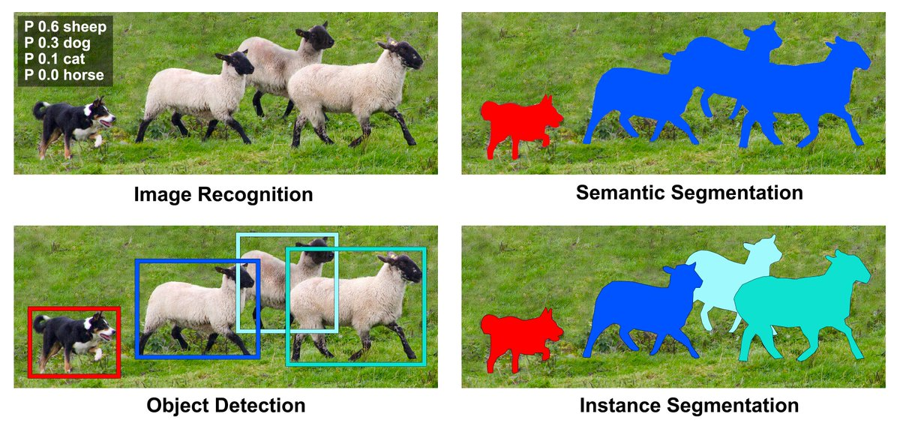

Slide 58
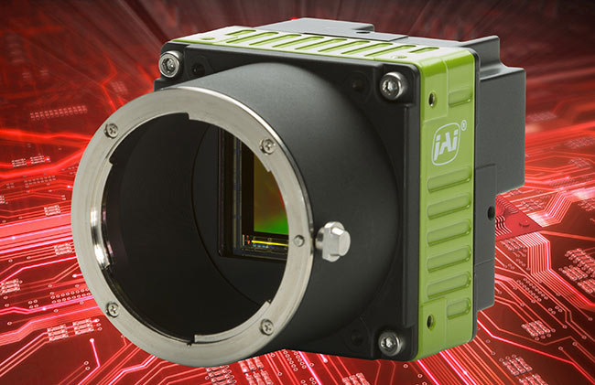
Cameras used in previous machine vision projects
Allied Vision
Basler
Cognex
FLIR Machine Vision
IDS Imaging Development
Systems
Imperx
JAI
Keyence
Sony
Teledyne DALSA
33

Slide 59
Difference between Machine Vision and Computer Vision
Computer vision and machine vision are overlapping technologies.
A machine vision system requires a computer and specific software to operate while computer vision doesn’t need to be integrated with a machine. Computer vision can, for example, analyze digital online images or videos as well as “images” from motion detectors, infrared sensors or other sources, not just a photo or video.
Machine vision is a subcategory of computer vision.
34

Slide 60
Computer vision
Computer vision is the field of computer science that focuses on replicating parts of the complexity of the human vision system and enabling computers to identify and process objects in images and videos in the same way that humans do.
It is a field of AI that enables computer to derive meaningful information from digital images and other visual inputs.
36

Slide 61


Slide 62
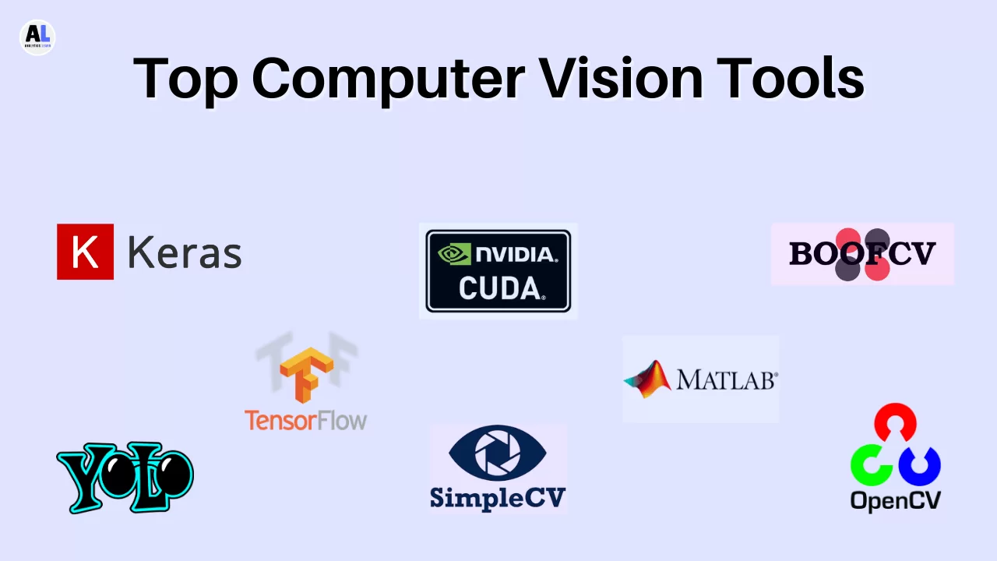
Commonly used tools in computer vision
OpenCV
TensorFlow
CUDA
Pytorch
MATLAB
Keras
SimpleCV
BoofCV
CAFFE
OpenVINO
DeepFace
YOLO
37

Slide 63
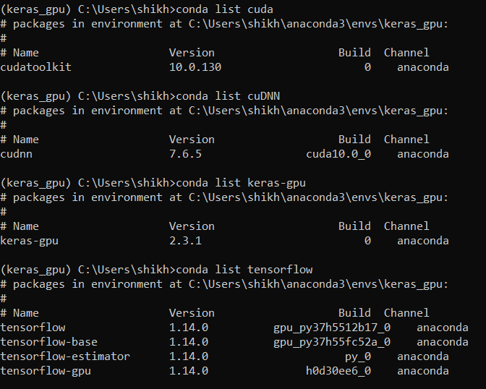

Slide 64



Slide 65
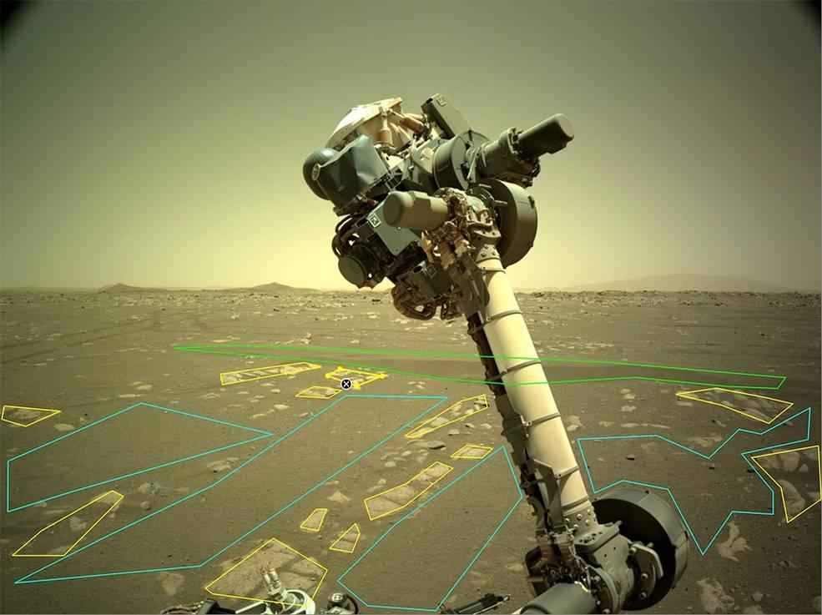

Problem, we are solving…
Obstacles Detection and Feature Segmentation on Lunar Surface
The robotic arm of NASA’s Perseverance rover
38

Slide 66

How will this course help you?

Slide 67
Problem Formulation
Goal - Rocks Detection on Lunar Surface with Image Segmentation
Core technologies - Python, OpenCV, Keras, Tensorflow, Django
Steps-
Understanding the basics
Getting Familiar with data
Understanding the technologies
Build, Check, Fine-tune and again Build
Application Development

Slide 68
What we will cover in this project?
Problem formulation
Python Programming Basics
Image data analysis and processing
Machine Learning (Theory and implementation)
Fine-tuning and Optimization
Deployment and designing GUI
Use-cases and Research Paper
Conclusion, Results and Further Opportunities
42

Slide 69
Program Structure
Whole Training Program is divided in 8 Weeks/Modules
Each Module consist of Live sessions, practical code implementation sessions.
Through each module, performance of participant will be evaluated that will reﬂect in ﬁnal performance reports.
Expected Schedule
Session time: 7pm - 8:00pm
Session days: Monday to Friday (5 sessions) for first 2 weeks.
Monday, Wednesday and Friday from 3rd week onwards.
Doubt Sessions: Everyday at 8:00 pm
Assignment submission day will be Sunday.
NOTE: Even if you miss any live session, video recordings of all sessions will be provided for life-time.
45

Slide 70
Advice for the further progress in the project-
Clear your fundamentals before it’s too late
Try reading and going through all the suggested resources
Complete your assignments, please
Attend as many live sessions as possible
Document everything for your own good
Discuss ideas with others, but don’t share you whole solutions
Trying developing new and creative ideas
Don’t be afraid to think outside the box
44

Slide 71
Progress and Performance Measures
Your solutions in the Assignments
Creativity of the approach
Code (Clear and Documented)
Your Behaviour and Discipline in sessions and workspace

Slide 72
All the Best!

